Slide 1
Class 04: Bullshit and CRP Wednesday, January 23
INFO 3402: Information Expositions Professor Brian Keegan brian.keegan@colorado.edu

Slide 2
Agenda
11:00 – 11:20 → Bullshit
11:20 – 11:40 → Critical response process
11:40 – 11:50 → Friday’s CRP and Assignment 1

Slide 3
Recap from last week
Epicycles of analysis: question, EDA, modeling, interpretation, communication
Characteristics of a good question, defining a data analytic question
Exploratory data analysis checklist

Slide 4
Frankfurt’s questions
“why our attitude toward bullshit is generally more benign than our attitude toward lying?” (pg. 12)
“a person who undertakes to bullshit this way through has much more freedom” (pg. 13)
“Someone who ceases to believe in the possibility of identifying certain statements as true and others as false can have only two alternatives” (pg. 15)
“Why is there so much bullshit?” (pg. 15)

Slide 5
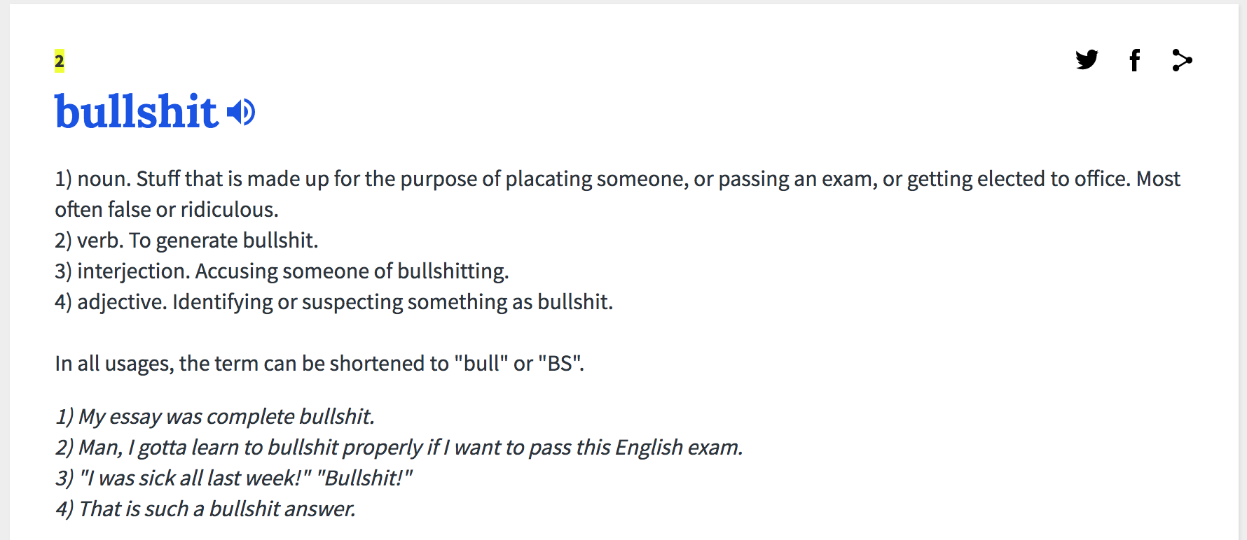
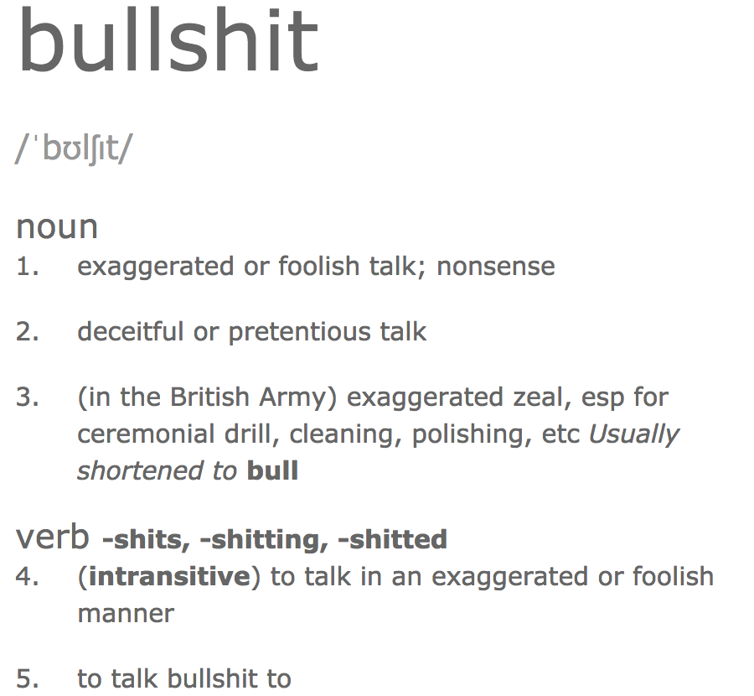
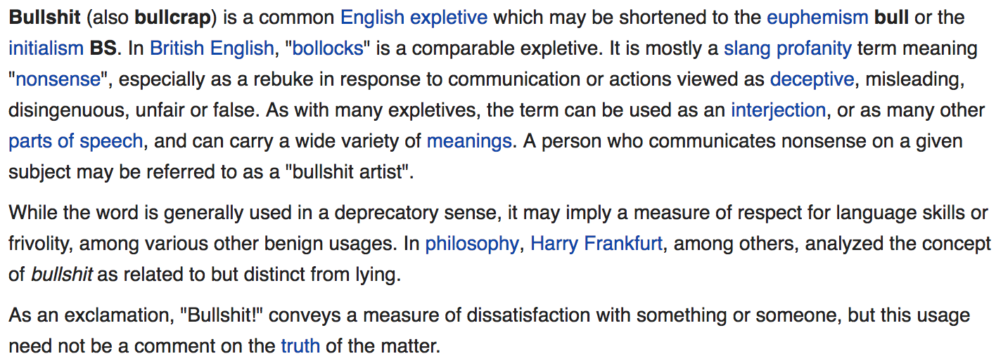
What is bullshit?

Slide 6
Humbug vs. Bullshit
Characteristics of humbug, according to Black (1980)
“deceptive misrepresentation, short of lying, especially by pretentious word or deed, of somebody’s own thoughts, feelings, or attitudes. “
What are other features of bullshit according to Frankfurt?
How is bullshit different than misinformation? propaganda? marketing?

Slide 7
Next classes
Friday: First in-class critical response process
Everyone is ready to present work-in-progress about Assignment 1, ~5 students randomly selected to present
Monday: Assignment 1 post submitted on Medium before 11am
Next week: new module → Retrieving
Web scraping, APIs, etc. starting
Demo on scraping the Oscars web site
Think about other websites or APIs you could scrape

Slide 8
Frankfurt’s definitions of bullshit
“lack of connection to a concern with truth –this indifference to how things really are” (pg. 8)
“connection between what people say and what they believe are suspended … unconstrained by a concern with truth” (pg. 9)
“tasks that are pointless in that they have nothing much to do with the primary intent or justifying purpose of the enterprise which requires them “ (pg. 10)
“bullshitting involves a kind of bluff … a matter not of falsity but of fakery … it is produced without concern with the truth, it need not be false” (pg. 12)
“the truth-values of his statements are of no central interest to him; what we are not to understand is that his intention is neither to report the truth nor co conceal it… the motive guiding and controlling it is unconcerned with how the things about which he speaks truly are” (pg. 14)

Slide 9
Thinking towards Assignment 1
How is bullshit different from misinformation, propaganda, marketing, etc.?
What does exploratory data analysis contribute to limiting or spreading bullshit?
What are examples of bullshit that have been refuted or amplified with EDA?
Rubric (conditional on meeting length, following good blogging style, not having errors, etc.)
A: Identify an example of bullshit in the wild, perform an EDA to call it out, write up the results
B: Identify examples of bullshit in the wild, outline how an EDA could be used to refute it
C: Identify examples of bullshit in the wild
>750 words, good use of formatting & images, due on Medium by Monday, January 28 before 11am

Slide 10
Critical response process
We will use this every Friday for our Weekly Presentations for you to get and give feedback on analysis
Three roles: an artist, a facilitator, and responders
Four core steps: Statements of meaning, artist as questioner, neutral questions, permissioned opinions

Slide 11
Three roles
Artist (typically a student)
Questioning their own work, at a stage where specific feedback is valuable, invested in evolving their project
Respondents (every other student in class)
Sincerely want the artist to make excellent work, can serve as peers or a general audience
Facilitator (typically me as instructor)
Initiating and managing steps, translating and coaching and policiing

Slide 12
Four core steps
Step 0: Artist makes a presentation
Step 1: Statements of meaning
“What was stimulating, surprising, evocative, memorable, challenging, different for you?” → NOT ”I liked…”
Facilitator should synthesize the diversity or convergence of themes
Step 2: Artist as questioner
Creator asks questions they have about their work
Facilitator helps clarify → NOT “What did you think?”
Step 3: Neutral questions from responders
Responders ask informational or factual questions and facilitator helps ensure they are neutral
Step 4: Permissioned opinions
Facilitator invites opinions with a specific protocol: “I have an opinion about X. Do you want to hear it?”
Artist’s decision to say “yes” or “no”

Slide 13
Role-playing with me as an artist
My work-in-progress EDA from ”Week 01 – EDA with House Expenditures.ipynb”
Step 1 – Statements of meaning: “What was interesting, surprising, memorable, challenging for you”
Step 2 – Artist as questioner: What questions does the artist have about the work?
Step 3 – Neutral questions from responders: “What are the most important ideas?”, etc.
Step 4 – Permissioned opinions: “I have an opinion about X. Do you want to hear it?”

Slide 14
Next classes
Friday: First weekly presentation
Everyone comes to class with work-in-progress ready to present
Approximately 5 randomly selected for critical response process
“Using EDA to combat bullshit” – examples, tutorials, etc.
Monday: Assignment 01 due on Medium by 11am
Next week: Retrieving
Getting data from HTML and APIs
Hands-on demo scraping the Oscars website
Weekly presentation on questions, data sources, and methods for your own scraping project
Assignment 2 due February 11, your own analysis or tutorial on scraping

